Slide 1

Spring Framework
Introduction to spring core (IOC)

Slide 2
Table of Content
Overview
Why Spring Framework
Spring History
Spring Modules
Inversion of control (IOC)
What is the beans in spring
Types of Containers
Inversion of Control
Spring Development Process (Step by Step)
Break
Time to Write code
Questions
Thanks

Slide 3
Overview

Slide 4
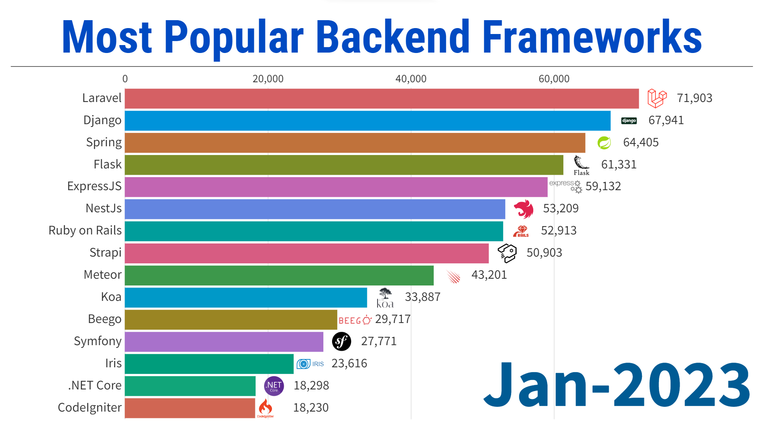
Why Spring framework
source

Slide 5
Why Spring framework (cont)
Inversion of Control (IoC)
Dependency Injection (DI)
Aspect-Oriented Programming (AOP)
Modular and Reusable Code
Declarative Transaction Management (ACID)
Simplified JDBC and ORM Integration
Flexible Configuration
Security
Community and Ecosystem

Slide 6
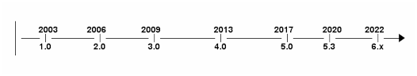
Spring / Spring boot Releases History
Spring versions

Slide 7
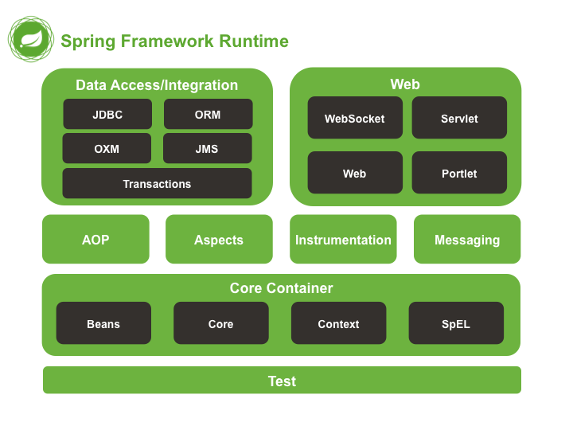
Spring Modules

Slide 8
Spring Modules (Additional)
Spring Cloud
Spring Data
Spring Batch
Spring Security
Spring for Android
Spring Web Flow
Spring Web Services
Spring LDAP

Slide 9

What is the Beans in Spring
is a Java object that is instantiated, assembled, and managed by the Spring IoC (Inversion of Control) container. The bean has some properties like :
Managed by the Spring Container
Bean Configuration (XML , Config Class and Annotations)
Dependency Injection
Lifecycle Management ( initialization and destruction methods)
Scopes (singleton , prototype …etc)
Aspect-Oriented Programming (AOP

Slide 10
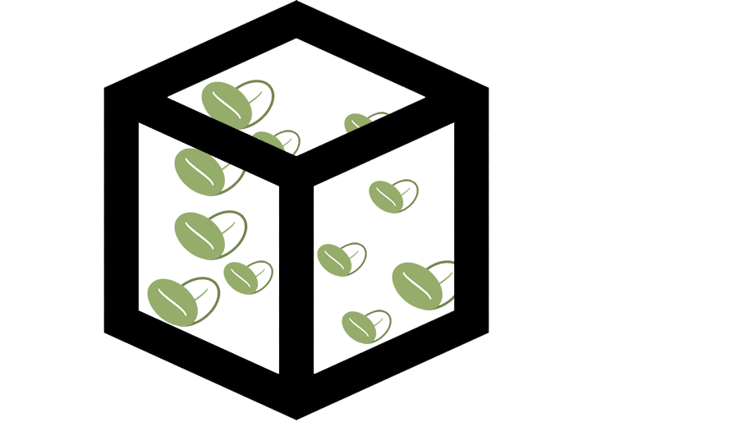
Types Of Containers
There are two types of Spring Container :
BeanFactory
This is a simple container that provides the fundamental features of the Spring IoC container. It is suitable for lightweight applications and environments with limited resource.
Application Context
includes all features of BeanFactory and provides additional functionality, such as event propagation, AOP integration, declarative mechanisms for services like declarative mechanisms for transaction management, and more.

Slide 11
Types Of Containers (differences)
 | BeanFactory | ApplicationContext
Initialization and Lazy Loading | Lazily loading | Eager loading
Configuration | s typically used for simple scenarios and XML-based configurations. | supports additional ways of configuration, including annotations, Java-based configuration, and XML configuration.

Slide 12
Inversion of Control
Inversion of Control (IoC)
is a concept where the control over the execution flow is transferred from the application code to the framework or container. In simpler terms, instead of the application controlling the flow of execution, it delegates control to an external entity (typically a container or framework).
So , the primary function of the Spring Container :
• Create and manage objects (Inversion of Control)
• Inject object dependencies (Dependency Injection)

Slide 13
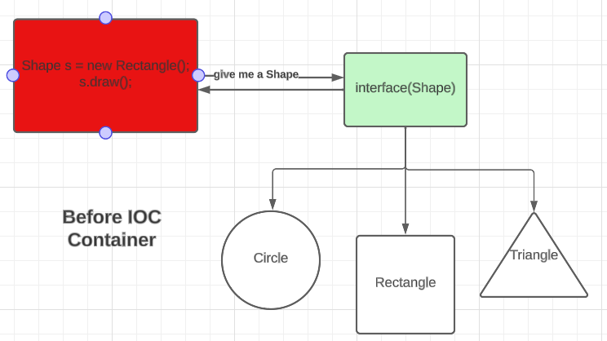
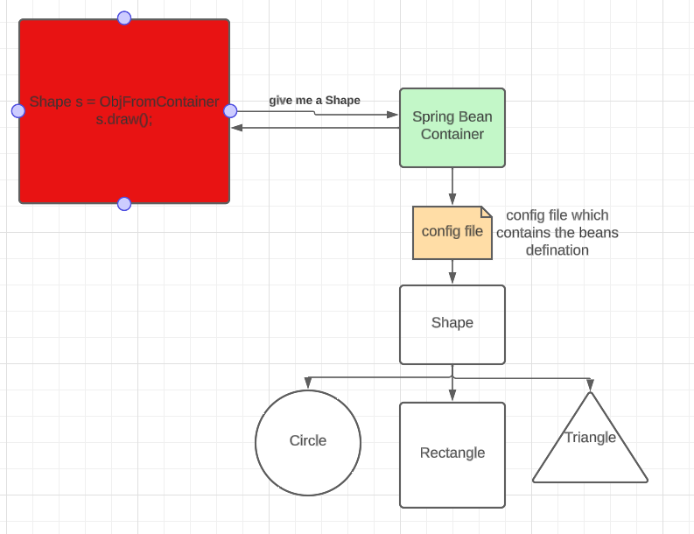
Inversion of Control (cont)

Slide 14
Spring Development Process (Steps)
Configure your Spring Beans
Create a Spring Container
Retrieve Beans from Spring Container

Slide 15
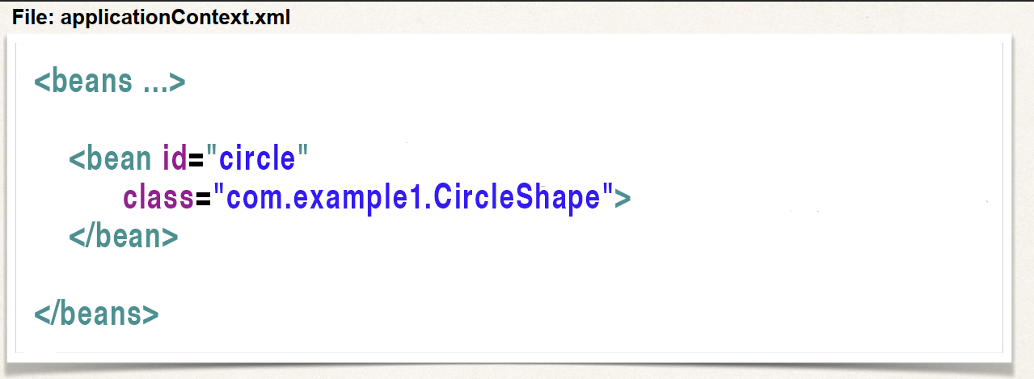
Step 1: Configure your Spring Beans

Slide 16
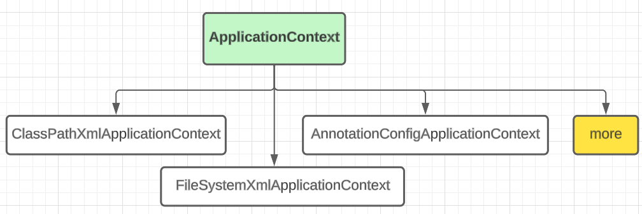
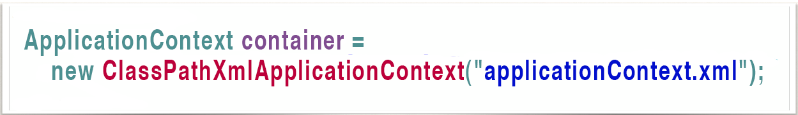
Step 2: Create a Spring Container

Slide 17
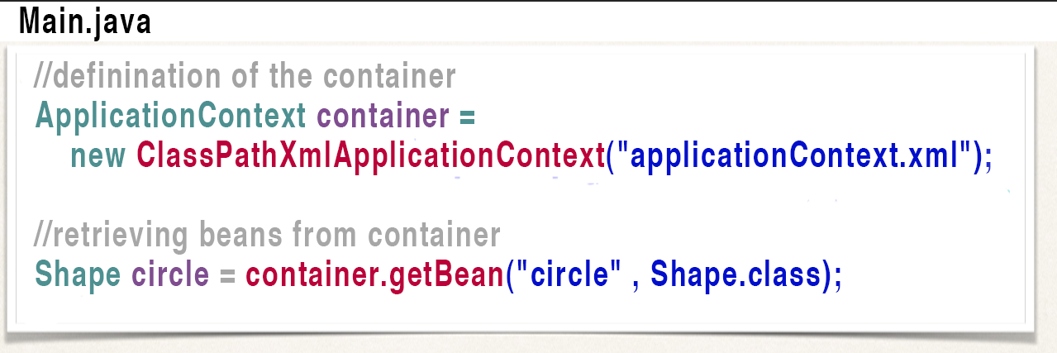
Step 3: Retrieve Beans from Container

Slide 18
5 minutes Break

Slide 19
Let’s write some code

Slide 20
Questions ?

Slide 21
THANK YOU

